Slide 1
Java APIs

Slide 2
What are APIs?
What Are APIs (Application Programming Interfaces)?
Rules and tools for software communication
Act as messengers between programs
How They Work
Enable requests for data or services
No need to know internal workings
Use endpoints (e.g., URLs) and methods (e.g., GET, POST)
Real-World Examples
Weather apps fetching forecasts
Social media logins (e.g., "Sign in with Google")
Payment systems (e.g., PayPal)
Why They Matter
Save development time
Connect apps and devices seamlessly
Power modern tech ecosystems

Slide 3
Java APIs
Using Java to interact with external services via their APIs
Creating APIs using Java

Slide 4
Using Java to Interact with APIs
Java can be used to send requests to REST APIs and process the responses using the HttpClient class.

Slide 5
import java.net.URI;
import java.net.http.HttpClient;
import java.net.http.HttpRequest;
import java.net.http.HttpResponse;
import java.time.Duration;
import org.json.JSONObject;
import org.json.JSONArray;
public class RestApiClient {
private static final HttpClient httpClient = HttpClient.newBuilder()
.connectTimeout(Duration.ofSeconds(10))
.build();
public static void main(String[] args) {
// Example GET request
String getUrl = "https://jsonplaceholder.typicode.com/posts";
try {
String getResponse = sendGetRequest(getUrl);
processGetResponse(getResponse);
} catch (Exception e) {
System.err.println("GET request failed: " + e.getMessage());
}
}

Slide 6
// Send GET request
private static String sendGetRequest(String url) throws Exception {
HttpRequest request = HttpRequest.newBuilder()
.uri(URI.create(url))
.header("Accept", "application/json")
.GET()
.build();
HttpResponse<String> response = httpClient.send(request, HttpResponse.BodyHandlers.ofString());
if (response.statusCode() != 200) {
throw new RuntimeException("Failed: HTTP error code : " + response.statusCode());
}
return response.body();
}
// Process GET response (assuming array of posts)
private static void processGetResponse(String responseBody) {
JSONArray posts = new JSONArray(responseBody);
System.out.println("Processing GET response...");
for (int i = 0; i < Math.min(posts.length(), 3); i++) { // Limit to 3 for brevity
JSONObject post = posts.getJSONObject(i);
System.out.println("Post ID: " + post.getInt("id"));
System.out.println("Title: " + post.getString("title"));
System.out.println("Body: " + post.getString("body"));
System.out.println("---");
}
}
}

Slide 7
Installation of OpenJDK 21
https://learn.microsoft.com/en-us/java/openjdk/download#openjdk-21
Mac M1, M2, M3
https://formulae.brew.sh/formula/openjdk@21

Slide 8
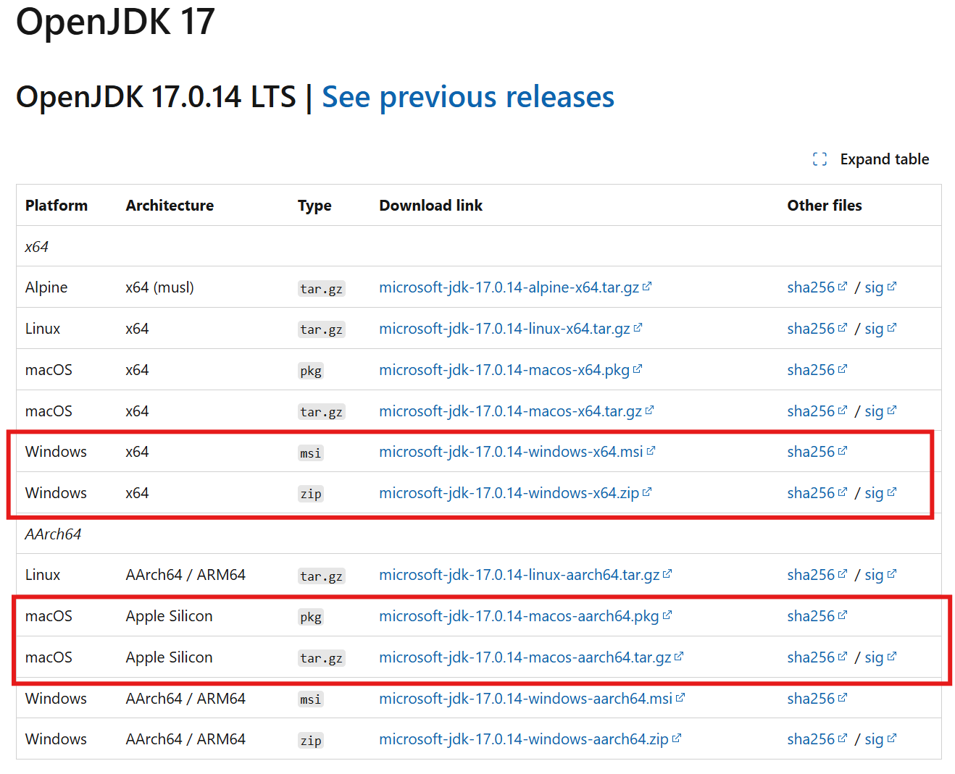

Slide 9
Maven
Maven is an open-source build automation tool primarily used for Java projects.
It simplifies and standardizes the build process by providing a uniform build system, dependency management, and a central repository for libraries and plugins.
Its key configuration file, pom.xml (Project Object Model), defines project details, dependencies, and build instructions.
Maven automates tasks like compiling code, running tests, and packaging applications, making development more efficient.

Slide 10
Installation of Maven
https://maven.apache.org/install.html

Slide 11
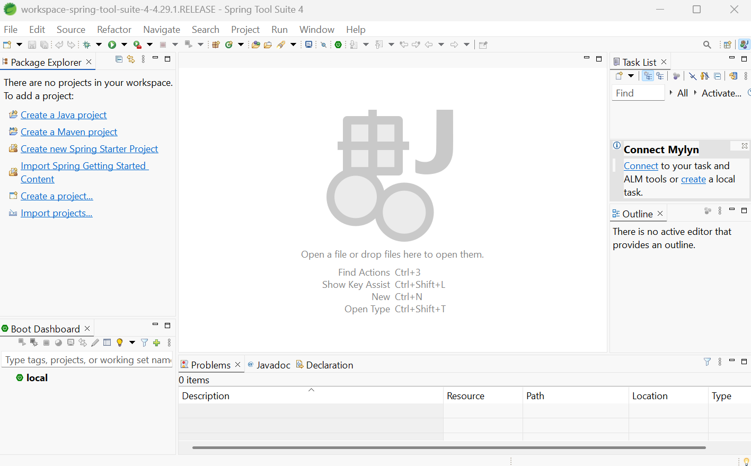
Spring Tool Suite (STS)
https://spring.io/tools

Slide 12
Building an Application with Spring Boot
https://spring.io/guides/gs/spring-boot

Slide 13
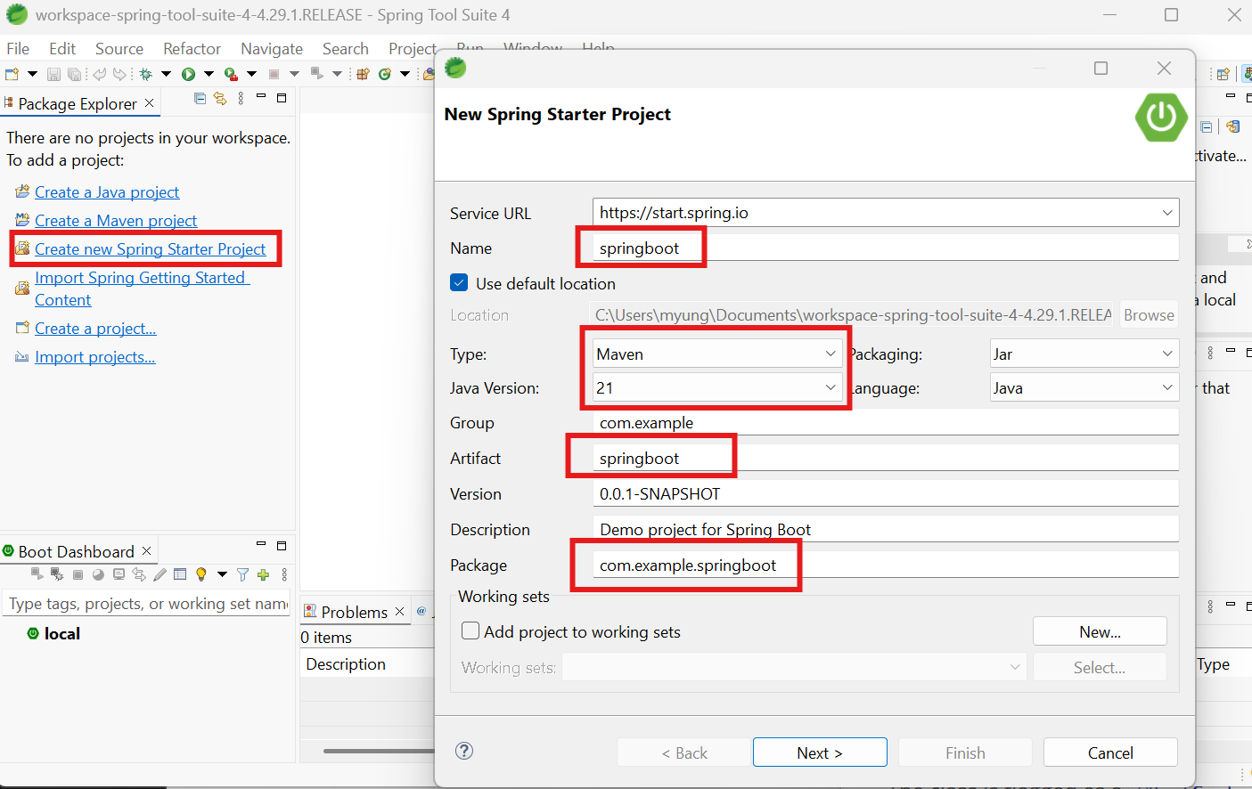

Slide 14
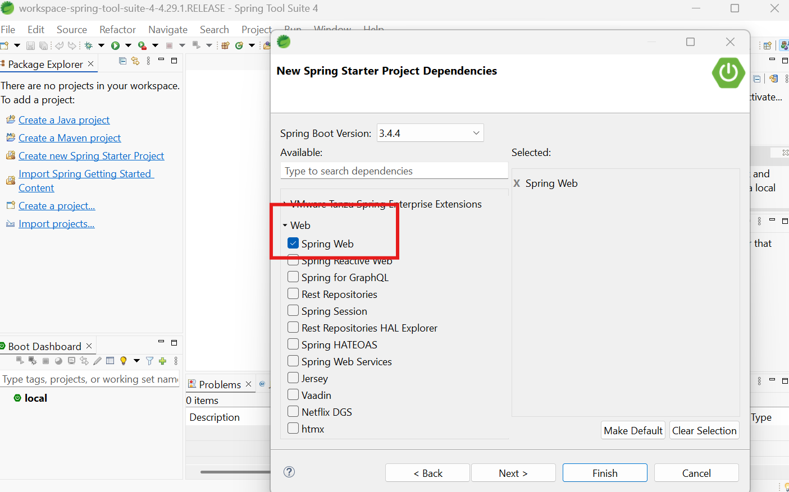

Slide 15
HelloController.java
src/main/java/com/example/springboot/HelloController.java
package com.example.springboot;
import org.springframework.web.bind.annotation.GetMapping;
import org.springframework.web.bind.annotation.RestController;
@RestController
public class HelloController {
@GetMapping("/")
public String index() {
return "Greetings from Spring Boot!";
}
}

Slide 16
src/main/java/com/example/springboot/SpringBootApplication.java
package com.example.springboot;
import java.util.Arrays;
import org.springframework.boot.CommandLineRunner;
import org.springframework.boot.SpringApplication;
import org.springframework.boot.autoconfigure.SpringBootApplication;
import org.springframework.context.ApplicationContext;
import org.springframework.context.annotation.Bean;
@SpringBootApplication
public class SpringBootApplication {
…..
@Bean
public CommandLineRunner commandLineRunner(ApplicationContext ctx) {
return args -> {
System.out.println("Let's inspect the beans provided by Spring Boot:");
String[] beanNames = ctx.getBeanDefinitionNames();
Arrays.sort(beanNames);
for (String beanName : beanNames) {
System.out.println(beanName);
}
};
}
}

Slide 17
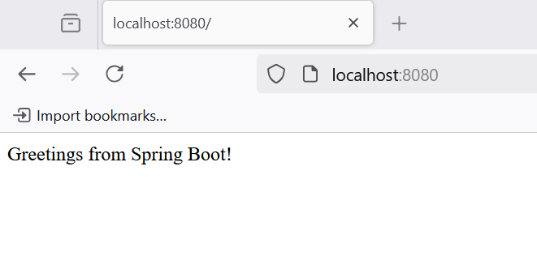
./mvnw spring-boot:run
OR
Run As → Spring Boot App

Slide 18
Web Application using Spring MVC
https://spring.io/guides/gs/serving-web-content

Slide 19
RESTful Web Service using Spring
https://spring.io/guides/gs/rest-service

Slide 20
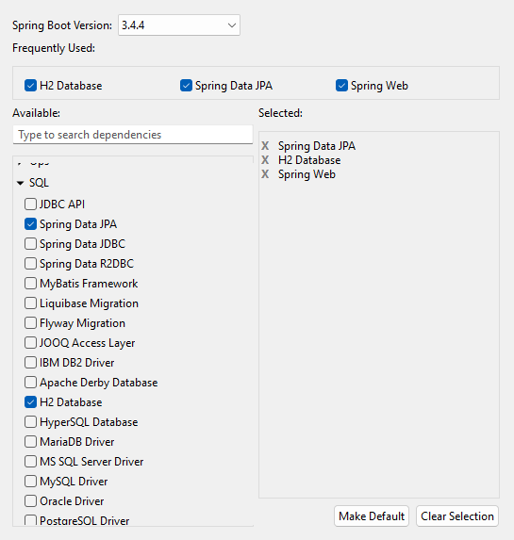
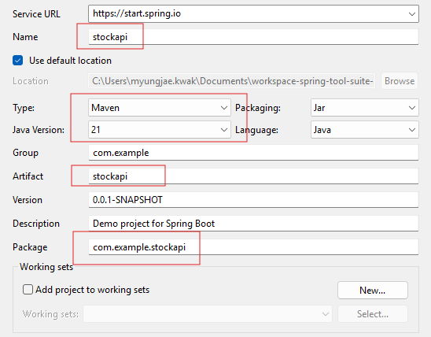
(Example) Stock Data API

Slide 21
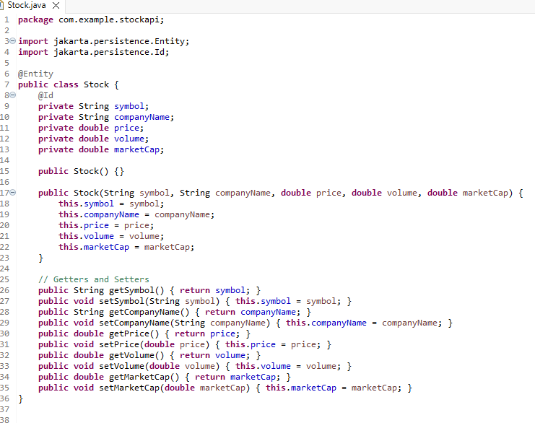

Slide 22
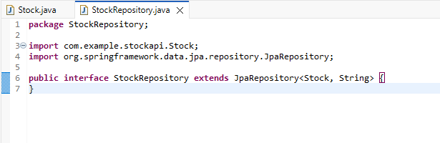

Slide 23
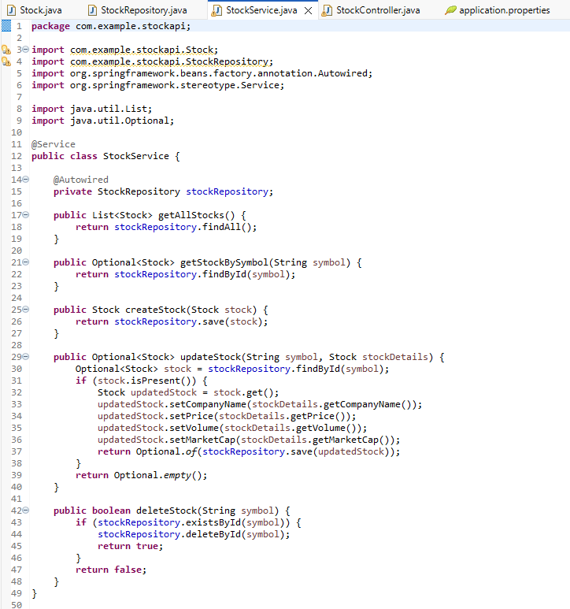

Slide 24
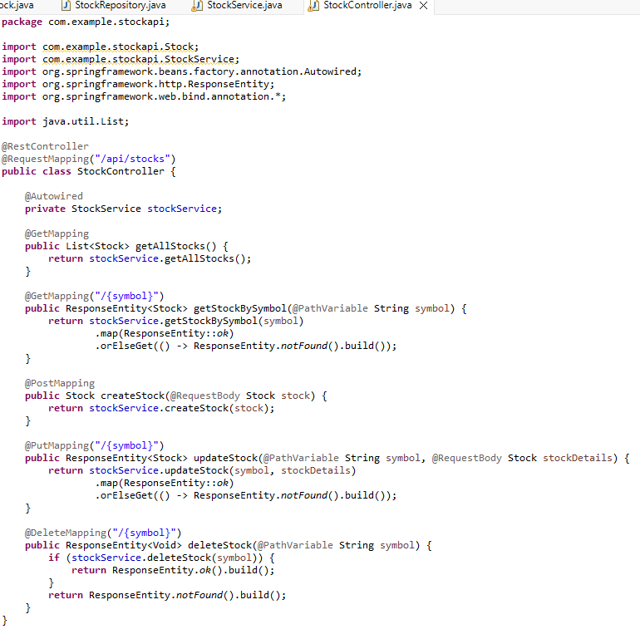

Slide 25
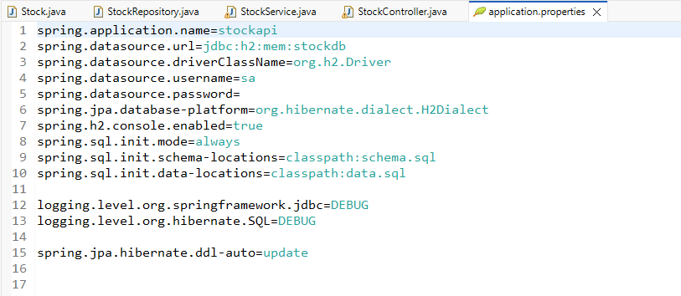

Slide 26
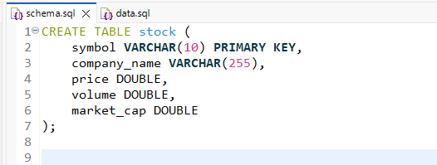
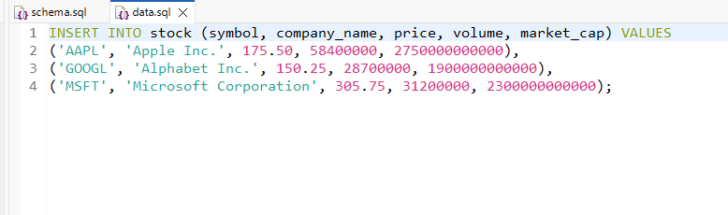

Slide 27
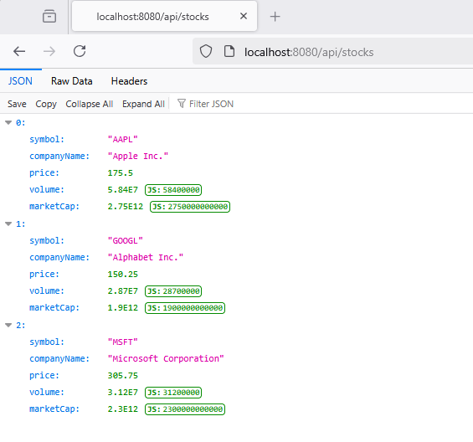
Run As -> Spring Boot App
Get All Stocks

Slide 28
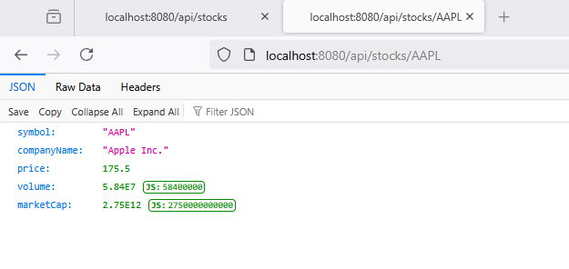
Get Specific Stock

Slide 29
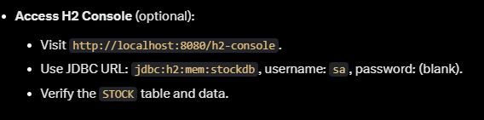
Create a New Stock
POST http://localhost:8080/api/stocks
Content-Type: application/json
{
"symbol": "TSLA",
"companyName": "Tesla Inc.",
"price": 250.75,
"volume": 98700000,
"marketCap": 800000000000
}

Slide 30
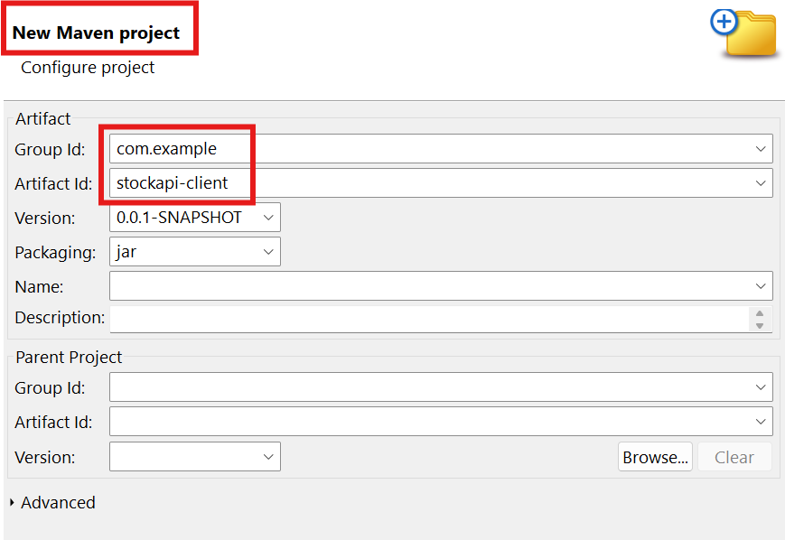
(Example) Java Client of Stock API

Slide 31
pom.xml
<dependencies>
<!-- Jackson for JSON handling (optional, for future enhancements) -->
<dependency>
<groupId>com.fasterxml.jackson.core</groupId>
<artifactId>jackson-databind</artifactId>
<version>2.15.2</version>
</dependency>
</dependencies>
<build>
<plugins>
<plugin>
<groupId>org.apache.maven.plugins</groupId>
<artifactId>maven-compiler-plugin</artifactId>
<version>3.11.0</version>
<configuration>
<source>21</source>
<target>21</target>
</configuration>
</plugin>
</plugins>
</build>

Slide 32
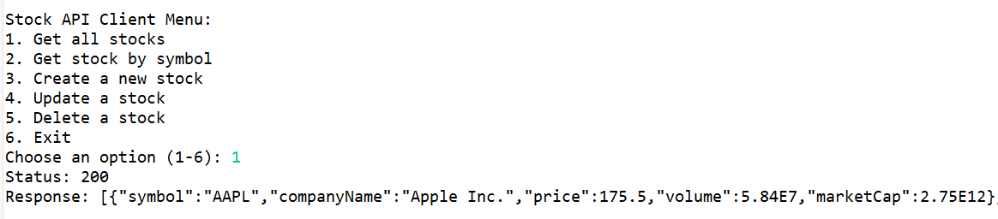
Run As -> Java Application

Slide 33
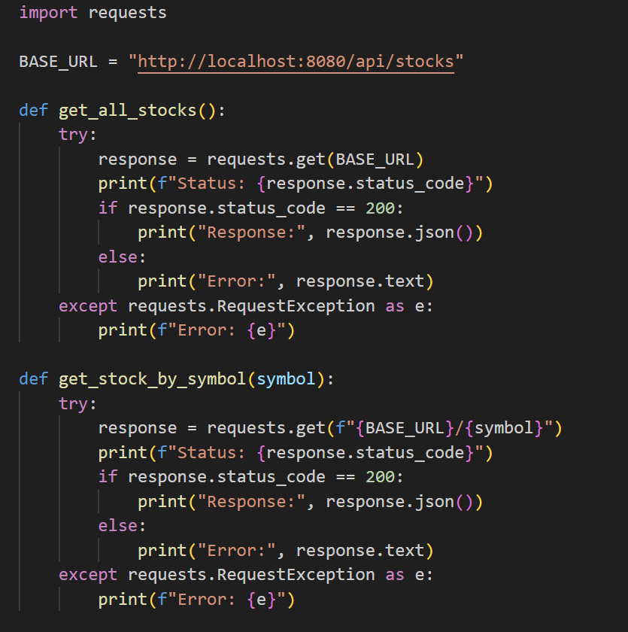
Python Client

Slide 34
Web Client
https://github.com/mkwak718/JAVA_APIs

Slide 35
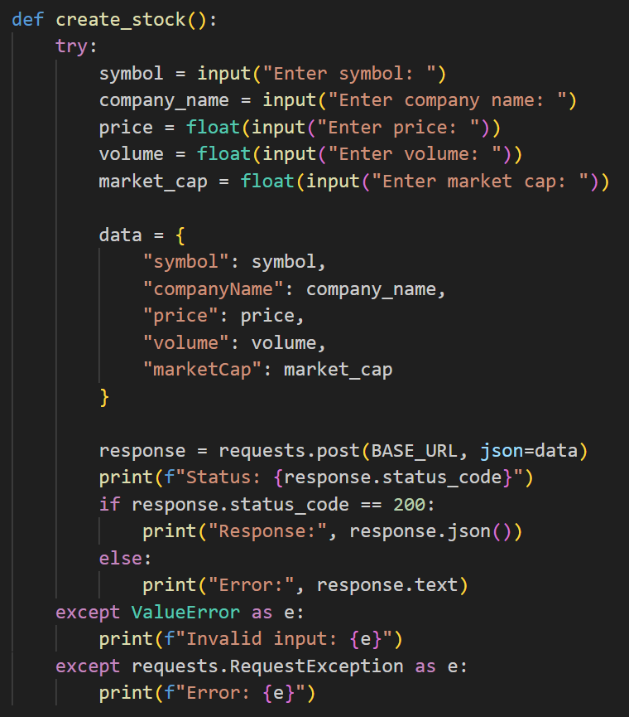
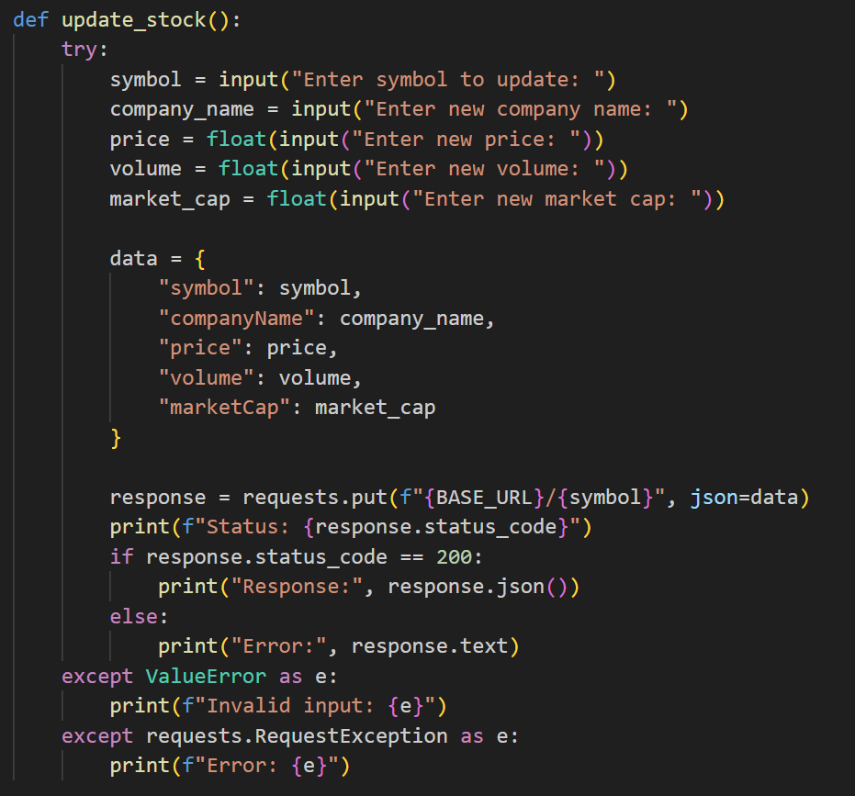

Slide 36
